Slide 1


Slide 2

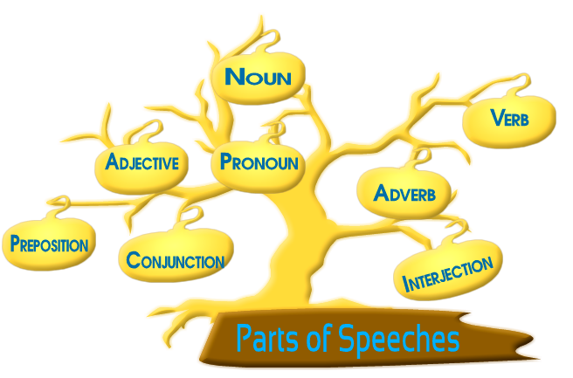
There are eight parts of speech in the English language but sometimes articles are also included in the list.

Slide 3
Poll Question
Which of the following is not a part of speech ?
Interjection
Adverb
Clause
Adjective

Slide 4



Answer
Option - C

Slide 5

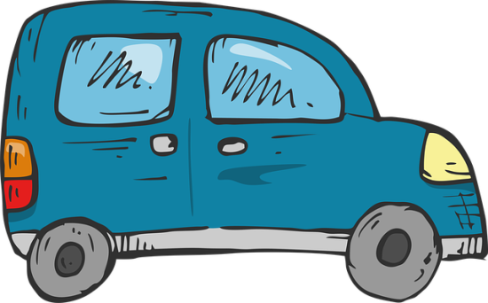
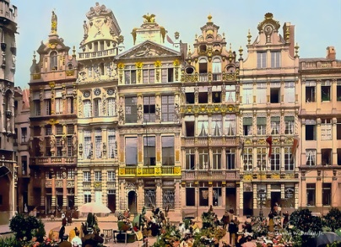



What is a Noun?????????
A noun is a………..

Slide 6

A NOUN is a word that refers to a thing (book), a person (Betty Crocker), an animal (cat), a place (Omaha), a quality (softness), an idea (justice), or an action (yodeling).

Slide 7
Poll Question
Which of the following is not a noun in this sentence?
My doctor and my orthodontist are neighbors.
doctor
orthodontist
are
neighbors

Slide 8
Answer
Option- C

Slide 9
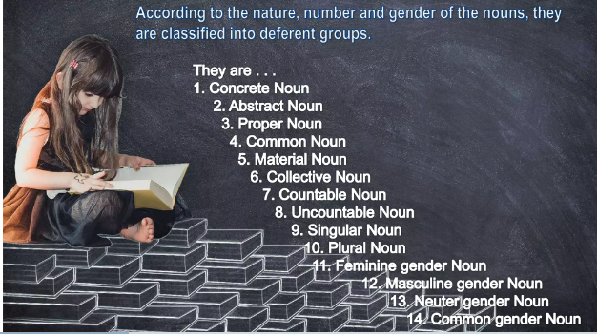

Slide 10
Poll Question
Which of the following is a type of noun ?
Idioms
Articles
Abstract
Confusing words

Slide 11
Answer
OPTION- C

Slide 12

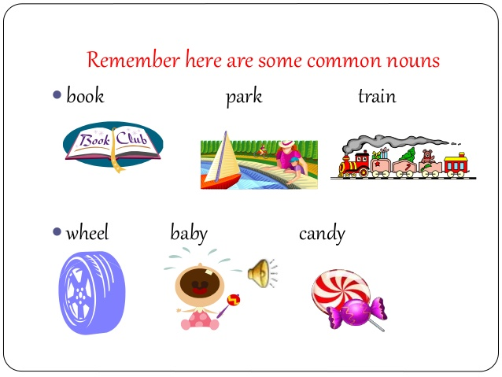

A COMMON NOUN refers to a person, place, or thing but is not the name of a particular person, place, or thing.
.

Slide 13
Poll Question
A ___________ noun does not name a specific person, place or thing.
A. Common noun
B. Proper Noun
C. Abstract Noun
D. Concrete Noun

Slide 14
Answer
Option - A

Slide 15
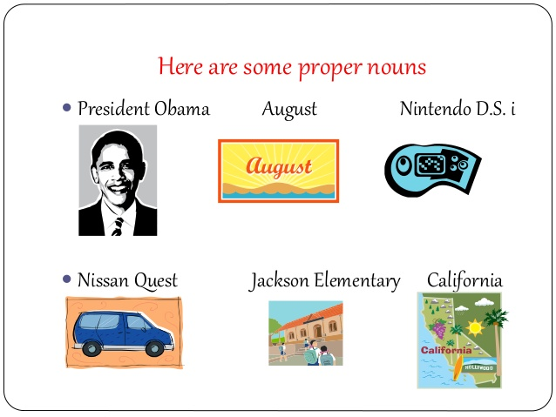
PROPER NOUN
A proper noun is the name of a particular person, place, or thing; it usually begins with a capital letter.

Slide 16
Poll Question
Which of the following is false about Proper Nouns ?
A. London, NewYork, Oprah winfrey are examples of proper nouns.
B. A proper noun represents the name of a specific person, place, or thing.
C. Proper nouns do not start with a capital letter.

Slide 17
Answer
Option -C

Slide 18
Activity – Choose Common & Proper Noun
teacher Mr. Johnson Emma toys
country man Indian Ocean website
Halloween candy January Lizard
lady day Helen Oreo

Slide 19

MATERIAL NOUN
A material noun is the name of material ,substance or ingredient which things are made of i.e. iron , copper and gold etc.

Slide 20
Note- A material noun is a type of common noun, but a distinction is made between the two. A common noun is usually a countable noun, but a material noun is an uncountable noun.

Slide 21
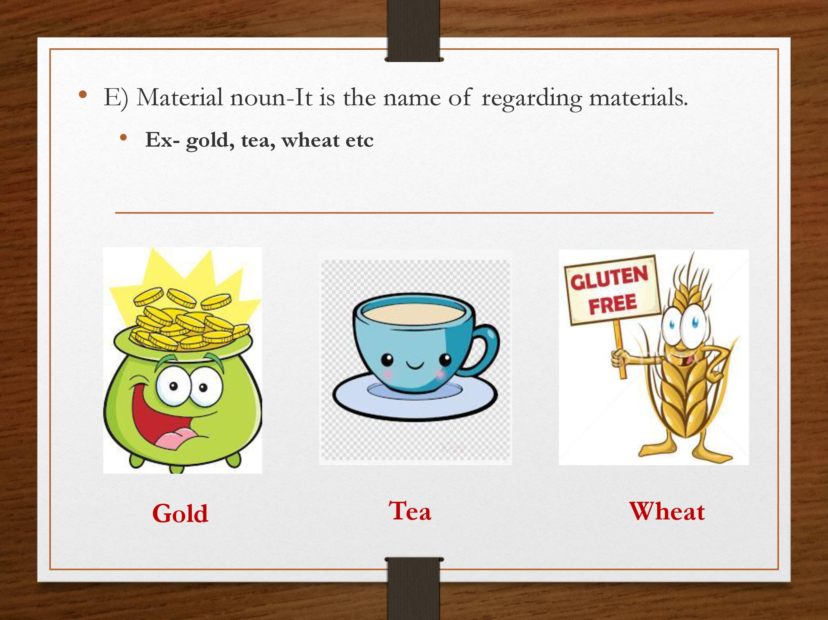

Slide 22
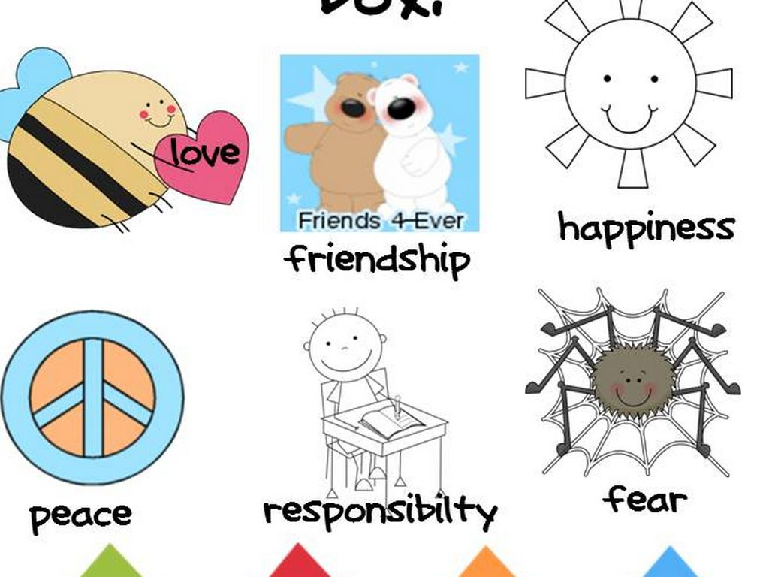
ABSTRACT NOUN.
An abstract noun is usually the name of a quality ,feeling ,action or state which can’t be perceived through five senses.

Slide 23
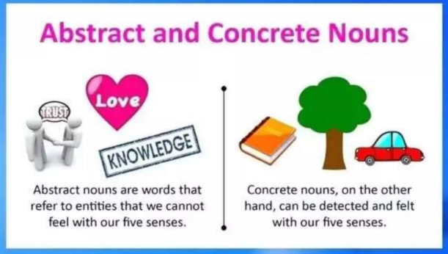

Slide 24
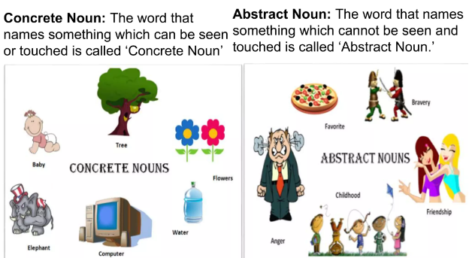

Slide 25
Countable Noun
Countable nouns are those that refer to something that can be counted using numbers. They have both singular and plural forms. e.g. cat/cats; woman/women; country/countries.
Countable nouns can be used with articles such as a/an and the or quantifiers such as a few and many

Slide 26
Uncountable/Mass Nouns
Uncountable nouns are nouns that come in a state or quantity that is impossible to count; liquids are uncountable, as are things that act like liquids (sand, air). Abstract ideas like creativity or courage are also uncountable.
milk, water, ink, sugar, butter
(not, a milk, one water, two sugar)
They are always considered to be singular, and can stand alone or be used with some, any, a little, and much.

Slide 27
.
Uncountable nouns can be paired with words expressing plural concept. Here are some examples of how to format interesting sentences with uncountable nouns .
Advice – She gave me a useful piece of advice.
Bread – Please buy a loaf of bread.
When we want to refer to the quantity of these items, we use values of measurement which are countable:
How much milk do you need?
We need a litre of milk.

Slide 28
Difference b/w Countable & Uncountable Noun
 | Countable Noun | Uncountable Noun
Eg:- | Seconds, Rupees etc. | Money ,time ,knowledge etc.
Verb | Singular with Singular noun Plural with Plural noun | Singular
Adjective | Many, few, a number of , the number of | Much , little , quantity of
Article | A/An/the can be used | only ‘the’ can be used

Slide 29
Poll Question
Which of the following is a countable noun?
A. Money
B. Time
C. Rupees
D. Knowledge

Slide 30
Answer
Option- C

Slide 31
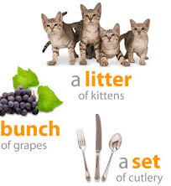
COLLECTIVE NOUN
A collective noun is the name of a group or collection of persons, animals or things regarded as a whole.

Slide 32
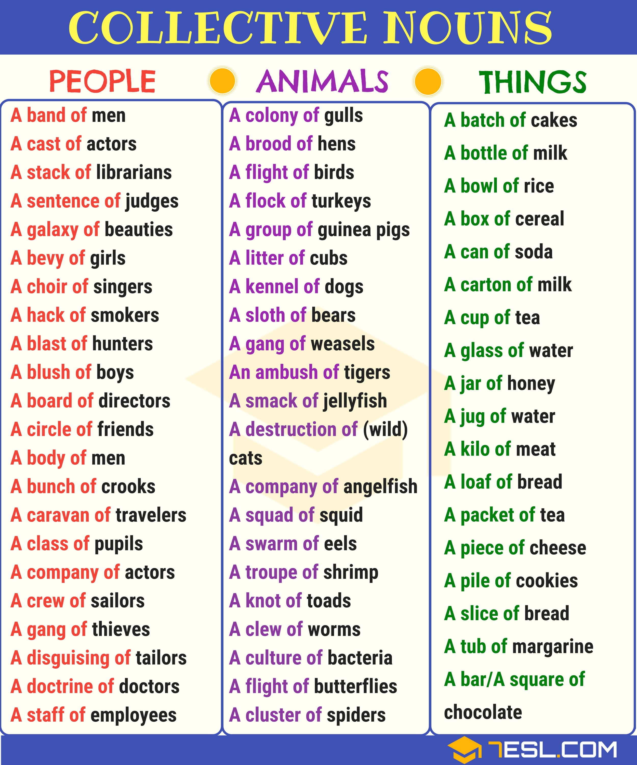

Slide 33
Poll Question
Which of the following is a collective noun? (a) Island (b) Bridges (c) Ambush (d) Women

Slide 34
Answer
Option- C

Slide 35
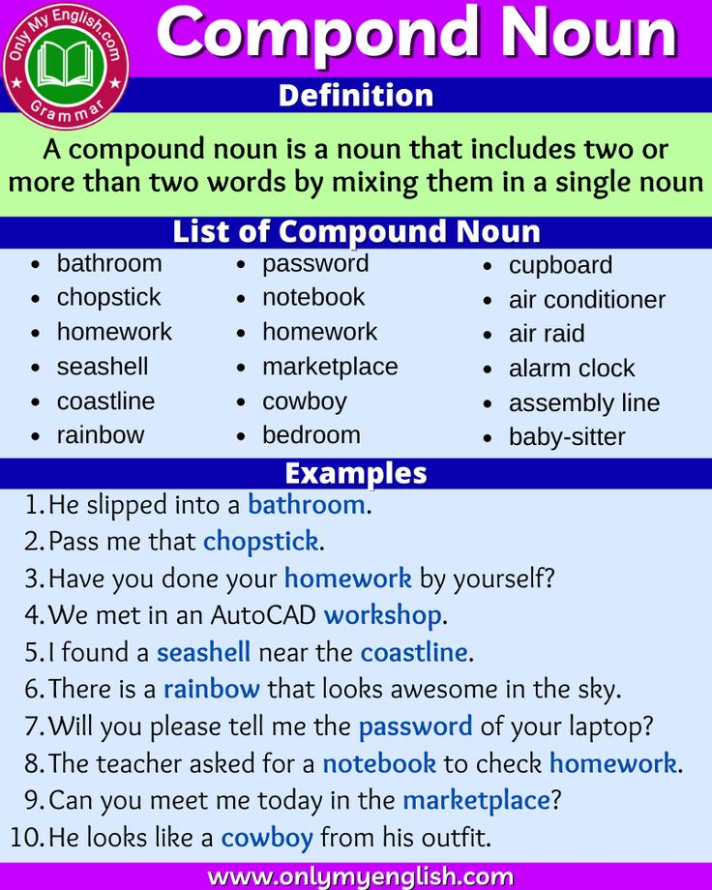

Slide 36
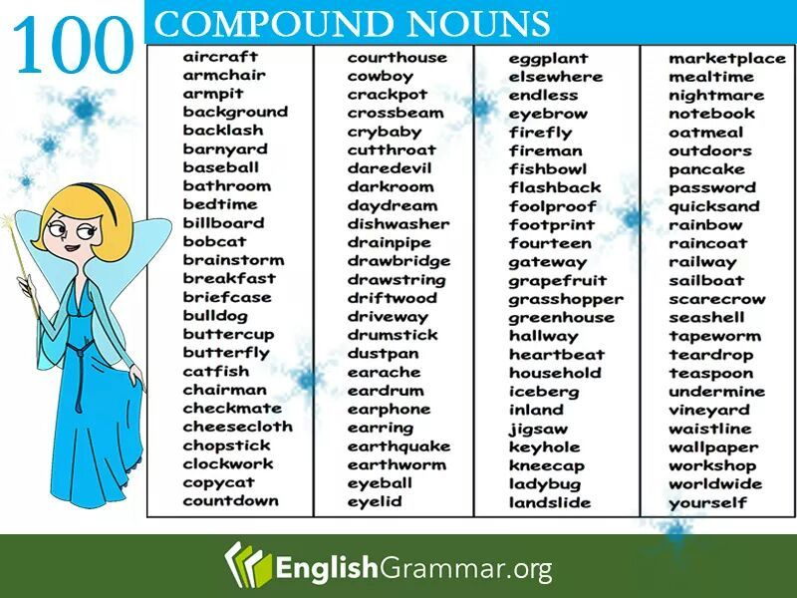

Slide 37
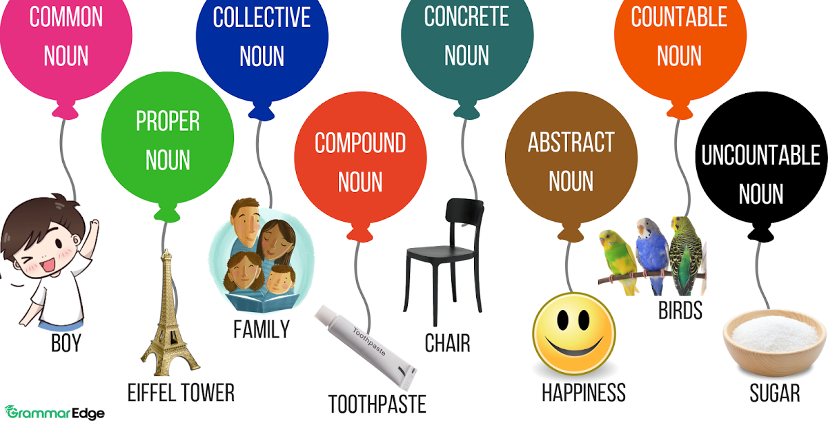
A Quick Review

Slide 38
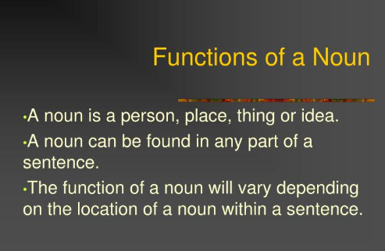

Slide 39

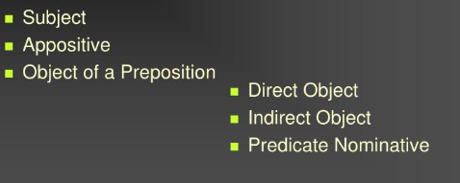

Slide 40
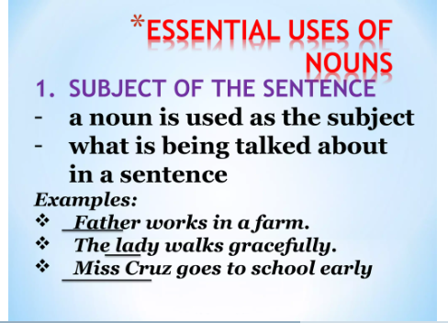

Slide 41
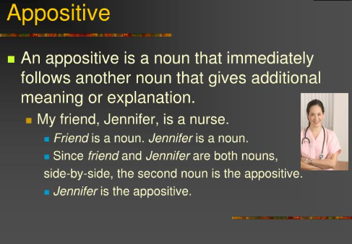

Slide 42
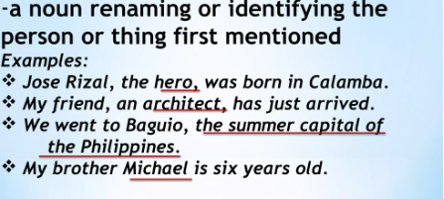

Slide 43
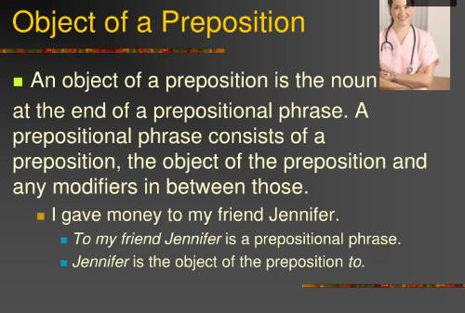

Slide 44
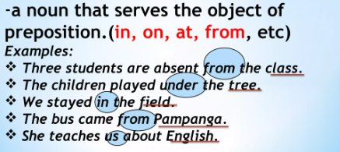

Slide 45
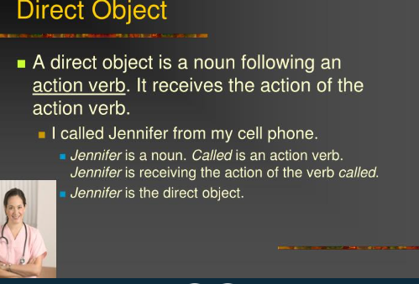

Slide 46
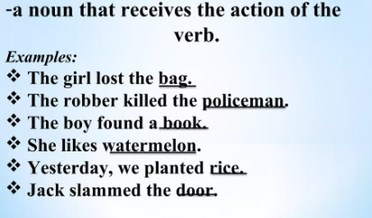

Slide 47
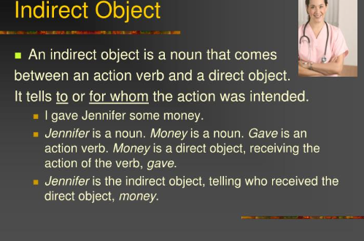

Slide 48
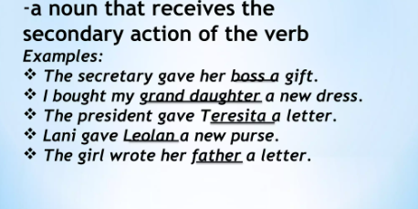

Slide 49
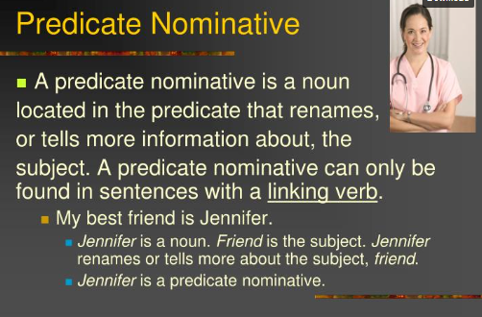

Slide 50
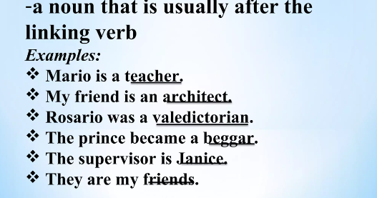

Slide 51
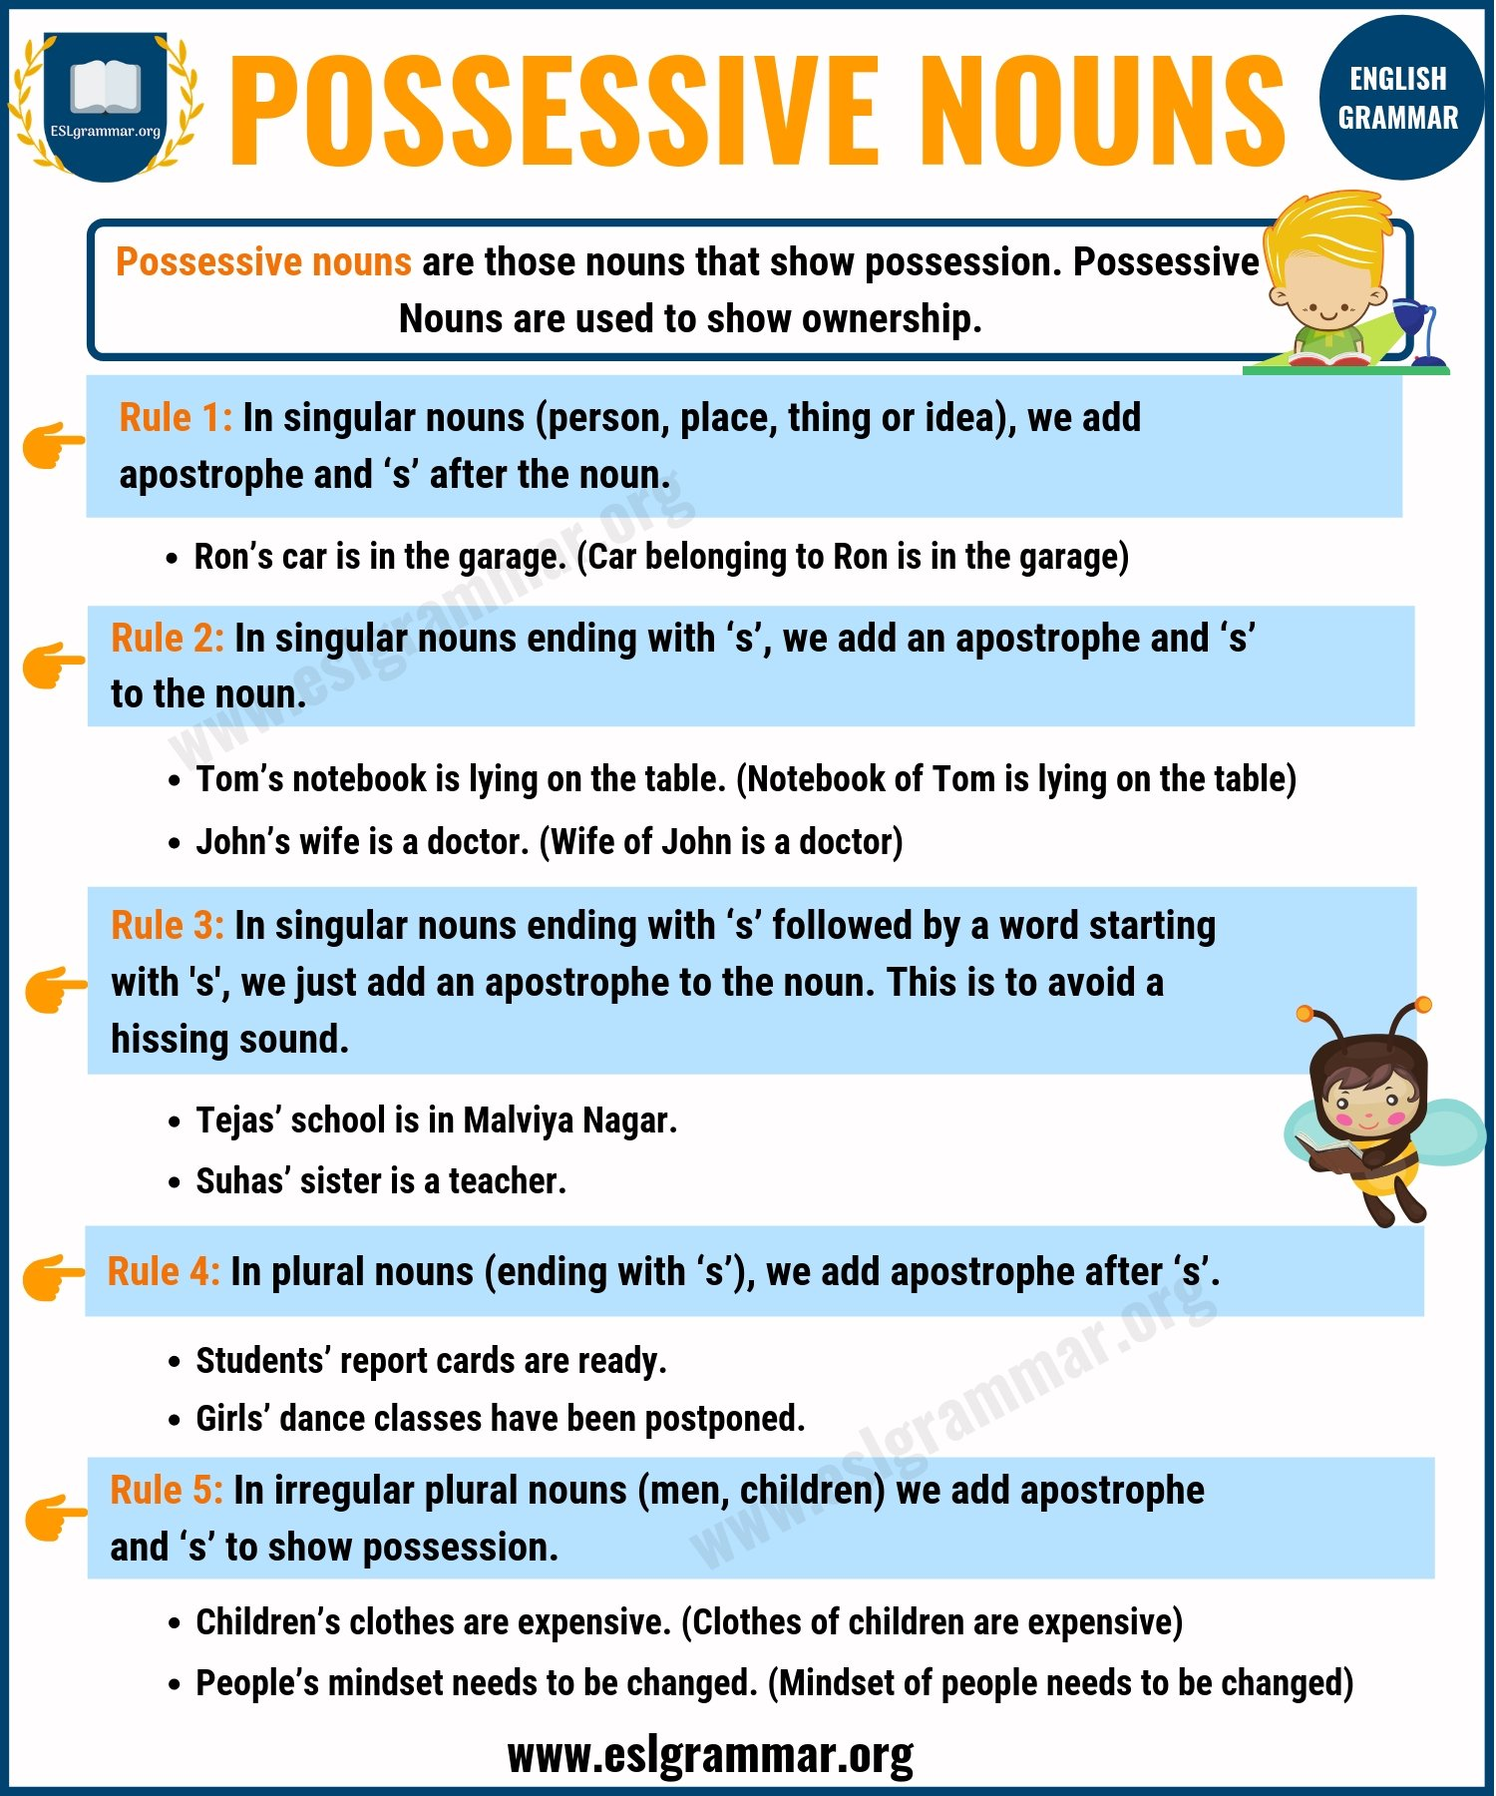

Slide 52
Many Middle Eastern---------------------- countries, including India, face ------------problems caused due to gender inequality. Gender inequality or gender discrimination, in simple terms, implies that the segregation and unequal treatment of individuals depending on their gender. It starts when -----------child is in his or her -----------------------womb. In many parts of India, illegal sex determination practices are still done, and if -----------------result states that it is ----------- girl child, at times, female feticide is performed . --------------main reason for the rising population in -----------------is gender inequality. The couple who have girl children try to have a male child as they consider that a male child is a grace to the family. -----------------sex ratio in India is highly skewed. According to a study, for every 1000 -------------------in India, there ----------------only 908 girls. The birth of a male child is celebrated with great ardor and pomp, but the birth of a female child is treated as a disgrace.--------------- Girls are even forced to drop out of school and are restricted from pursuing higher studies. They are considered as a burden and are objectified. According to -----------------statistics, almost 42% of married ----------------were forced to marry as a child, and according to UNICEF, 1 out of 3 child brides in the world is a girl from India. We must take initiatives against ------------act of female ---------------and child marriage. Also, the government must look into this grave issue of gender inequality because it is pulling down the country’s development. Unless and until women are given the same status as men, ---------------country can’t progress, and thus, gender inequality must come to ---------------end.

Slide 53
Many Middle Eastern countries, including India, face the problems caused due to gender inequality. Gender inequality or gender discrimination, in simple terms, implies that the segregation and unequal treatment of individuals depending on their gender. It starts when a child is in his or her mother’s womb. In many parts of India, illegal sex determination practices are still done, and if the result states that it is a girl child, at times, female feticide is performed . The main reason for the rising population in India is gender inequality. The couple who have girl children try to have a male child as they consider that a male child is a grace to the family. The sex ratio in India is highly skewed. According to a study, for every 1000 boys in India, there are only 908 girls. The birth of a male child is celebrated with great ardor and pomp, but the birth of a female child is treated as a disgrace. Girls are even forced to drop out of school and are restricted from pursuing higher studies. They are considered as a burden and are objectified. According to the statistics, almost 42% of married women were forced to marry as a child, and according to UNICEF, 1 out of 3 child brides in the world is a girl from India. We must take initiatives against the act of female feticide and child marriage. Also, the government must look into this grave issue of gender inequality because it is pulling down the country’s development. Unless and until women are given the same status as men, a country can’t progress, and thus, gender inequality must come to an end.

Slide 54


